Slide 1
OMHARN Women's Health Panel
Dr Olive Wahoush
March 17th 2012

Slide 2
Goals
Building the knowledge base that will help Excellent Care For All to become a reality for Ontario’s multicultural population
Supporting patient-centred care that is responsive to diverse individual needs
Building understanding of how people from diverse backgrounds access the health care system, with a view to providing integrated care across multiple access points.

Slide 3
Objectives
Lay the groundwork for increasing the scope, amount and quality of multicultural health research with an Ontario focus, making best use of existing research and seeding new research ideas that may attract future funding from the other funding agencies
Support knowledge transfer activities that better inform policy and practice related to multicultural health in the province by providing information in formats useful for healthcare policymakers, educators, practitioners, and administrators.

Slide 4
Question 1
From my perspective what is the biggest challenge we face today for advancing multicultural health research?

Slide 5
FIGURE 1. An Emerging Model – Phase 4
ENVIRONMENT POPULATION HEALTH OUTCOMES
CHARACTERISTICS BEHAVIOR
Health Care
System
External
Environment
Predisposing Enabling Need
Characteristics Resources
Personal
Health
Practices
Use of
Health
Services
Perceived
Health Status
Evaluated
Health Status
Consumer
Satisfaction
(Andersen, 1995)
Andersen, R. M. (1995). Revisiting the Behavioral Model and Access to Medical Care: Does it Matter? Journal of Health and Social Behavior, 36, 1-10.

Slide 6
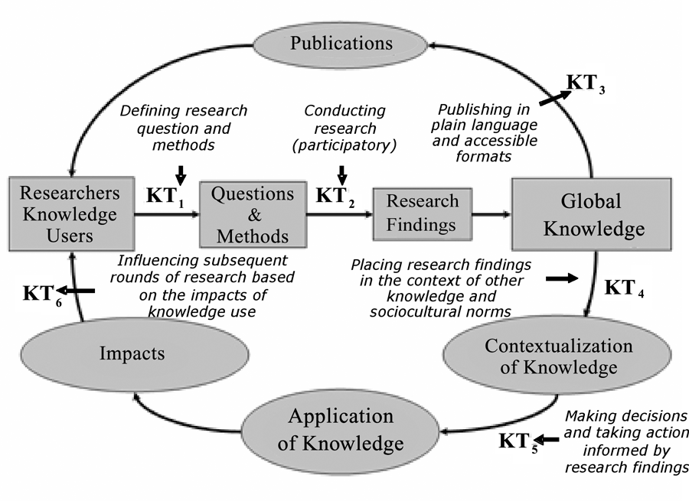
CIHR Knowledge Translation Model (2010)

Slide 7
My perspectives
The biggest challenge is relevance
Lack of agreement that there are problems with significant consequences for many and that this is worth studying
What is meant by multicultural – does it stop at immigrants? And when do immigrants stop being immigrants?
Limited engagement with other disciplines/professions
Families and communities today and in future?

Slide 8
Consider commonalities with population at large
Poverty masks other variables
Women more likely to live in poverty and to remain in poverty longer than men
Most women become parents which also increases poverty in the early years

Slide 9
Why does relevance matter?
Funding
Support to complete research
Enhanced potential for action based on results/findings
Sustainability

Slide 10
Question 2
What is the most important thing that OMHARN can do to best address this challenge?

Slide 11
Response
To decide
to work with government and other policy makers in determining direction
Or
To work independently and seek connections to inform for change and improvements

Slide 12
Response cont’d
To determine scope and identify limits
Network with other networks e.g. WCI, RIHNs, Human Rights networks, Professional Associations
Make multiculturalism more than immigrant work – Part of the fabric of every study (similar to gender)
Develop strong tools that can capture the diversity of/within multiculturalism
Promote connections to curricula, policy and standards

Slide 13

Celtic Knot

Slide 14
Thank you

