Slide 1
Resettlement in Canada: Anticipation and realities for health Government Assisted Refugees
Canada’s Role in Global Health: Thinking Globally Acting Locally

Slide 2
Objectives for this presentation
To share an understanding of the Global view of refugee and immigrant movements
Global
Describe the picture of refugee movements
Outline the pre-transfer processes
Local
Outline early reception in Canada
Report a few findings from my research in this region

Slide 3
Migration numbers
214 million migrants in the world (estimated by Internal Office of Migration)
Canada receives between 250, 000 -300,000 per year
Migrants represent approximately 3% of the global population

Slide 4
Populations of Concern to UNHCR (Jan 2011)
Refugees (10.5m)
Asylum seekers (refugee claimants) (837k)
Internally Displaced Persons (14.7m)
Returned refugees and asylum seekers (197k)
Stateless people (3.5m)
Total population of concern = 33.9 million)
Source: http://www.unhcr.org/4ec230f516.html

Slide 5
Understanding the terms: Refugees, Refugee Claimants (Forced Migrants) & Immigrants
The term refugee applies to individuals who meet the UN convention definition of refugee.
The category ‘refugee’ includes:
‘convention refugees’ selected & sponsored overseas
Successful ‘Refugee Claimants’ (Asylum seekers).
Refugee claimants are individuals who arrive in Canada and then apply for recognition as a refugee.
Immigrants comprise many categories:
Notes:
Immigration is a very important part of population growth in Canada.
Trends show:
consistent increases in numbers,
increasing diversity in source countries of immigrants
increased numbers of visible minorities.
New cultures, languages and expectations to Canadian health care settings.
More than 20% of recent immigrants are children.
CLAIMANTS do not have the same rights as refugees and are temporary residents

Slide 6
Refugee Process
Brief description of refugee process
Individuals apply to a UNHCR office
Determination process – convention refugee?
Convention refugees - interviewed by Canadian Mission
IOM arranges screening, preparation and travel
Who decides to come to Canada
Parents 69% (9)
Others 31% (4)

Slide 7
Refugees coming to Canada
About 30,000 refugee resettle in Canada every year
Approximately half come to Ontario
Majority are families with children
Change to selection
Ongoing changes to support system
Population rarely included in research studies and difficult to identify in datasets

Slide 8
Acting Locally

Slide 9
Reception in Canada
Receiving Centre notified 10 – 14 days pre arrival
Transportation from airport to receiving centre
Temporary accommodation, health card application, health checks completed (first 3 days)
Assessment for needs – for example language, life skills
Supports arranged (case manager or other model)

Slide 10
Reports from two studies
Study one – refugee families living in Canada up to five years
Study two – Government Assisted Refugee families within 3 months of arrival and followed until in Canada for 18 months

Slide 11
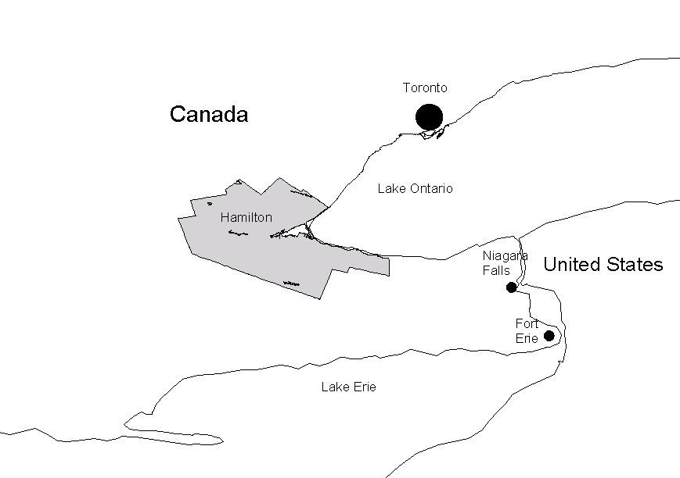
Hamilton Ontario
Map showing location of Hamilton CMA in South Central Ontario
Source: (GIS McMaster University, 2005)

Slide 12
Study One
Findings and Conclusions:
Mothers actions and experiences when managing the acute and minor illnesses of their ‘normally well’ preschool children
LENS ONE
Perspective from Existing Documentation
Secondary data sources:
Citizenship and Immigration Canada (CIC)
Ontario Medical Association
District Health Council
Canadian Institute of Health Information
Statistics Canada
Census 2001
Vital Statistics
National Population Health Survey
Community Health Survey
LENS TWO
Provider Perspectives:
Health care providers
Settlement support providers
Other support agencies
LENS THREE
Perspective of Mothers:
Refugee Mothers with at least one preschool child
Refugee claimant mothers with at least one preschool child
FIGURE 1: Three Lenses informing the picture of Refugee mother and refugee claimant mothers behaviours when they manage acute and minor episodic illnesses of their ‘normally well’ preschool Children.

Slide 13
Study 1: Findings Overall
Lens 1: Existing Documentation
Little information about the study population
Lens 2: Provider Agencies
Settlement support (n=7)
Do not serve refugee claimants & have limited information about their needs.
Primary health care (n=13)
Shortage of family doctors.
Providers rarely know who refugees and refugee claimants are among their clients.
Notes:
Information about the study population most often did not distinguish refugees and almost none included refugee claimants.
Often ethno-racial focus on single group and findings related primarily to the group rather than broader contexts and systems
Socio-economic environment: High proportion of children living in low income (Hamilton 23% vs Ontario 17%).
Provider agencies included: 13 primary health care providers & 7 settlement support agencies
total of 55 mothers participated in this study:
in one of three focus groups (n = 22) or/
in semi structured interviews (n = 33)

Slide 14
Lens 3: Mother’s (n = 55)
Majority of mothers had less than 3 children.
Education U shaped curve
higher proportion less than elementary or had post secondary than in other reports & general population.
More than 50% of mothers knew no-one in Canada.
40% - 60% were lone parents.
56% were first settled in Hamilton & 46% were secondary migrants.

Slide 15
Findings related to enablers
All mothers reported they had health insurance; more reported provincial health insurance (OHIP) than Interim Federal Health Plan.
More than two thirds (70% - 80%) reported they had a regular provider of health care with a family doctor or a doctor at a CHC.
Less than provincial reports (91% 2003)

Slide 16
Experiences accessing health care
Most reported very positive health care experiences
Some reported negative experiences
Financial costs were high (transport & medications) & resulted in mothers missing meals
Refugee claimants 68% vs Refugees 36%
Unmet needs related factors - interpreter support, transport and health insurance.
Notes:
+ve
many appreciated the samples of medications
the attention of well educated professionals
-ve
such as needing to pay a fee before their sick child could be seen
encountering racist behaviour.
Costs
contributed to difficult decisions about meals or medications.
mothers missing meals
Refugee claimants 68% vs Refugees 36%
Unmet needs
Enablers are important to support access to health care when needed; eight mothers reported experiences where they were not able to get health care for their child when it was needed.

Slide 17
Full Range of Service Provider Agencies surveyed
Primary health care providers (n=13)
Emergency departments
Community Health Centres (CHCs)
Single doctor practice
Walk-in clinics
Group practices
Alternative health practitioner
Settlement support agencies & agents (n=7)
Notes:
A few settlement support agencies that also provide primary health care services.
Agencies were identified from city directories, websites and primary health care agencies working with immigrant populations were named by local settlement agency staff.
Leaders in each agency were approached for their consent to participate and were asked to nominate staff familiar with immigrant and refugee populations.
Staff were asked for their consent to participate in a semi-structured interview.
All interviews were arranged on site at a time convenient for the respondent and confidentiality measures were explained.

Slide 18
Results
Primary health care providers rarely know who among their patients are refugees or asylum seekers
Some reported they had witnessed discrimination by colleagues and did not know what to do
A large majority had no preparation for working with culturally diverse populations; a few had completed people skills training.
Notes:
Results: Front line staff representing 20 agencies were interviewed about their experiences working with refugee and asylum seeking families. Details about characteristics of each primary health care agency were obtained. Provider perspectives included information about perceived needs of refugee and asylum seeking families, availability of child health specific expertise, access to services, primary health team structure, interpreter supports and challenges faced by these families. Providers also shared that they rarely know who among their patients are refugees or asylum seekers, a few stated they had witnessed or knew of incidents of discrimination by health care providers. Primary health care providers also reported that they had no preparation for working with culturally diverse populations and worried that their intentions may be misunderstood.

Slide 19
Congruent findings identified in each of the 3 Lenses
Racist behaviour
Limited offers of language help
Low income
Impact of direct and indirect costs to mothers seeking health care (all times especially at night and in cold weather)
Fear
Providers feared causing offence to their clients
Mothers feared being judged as poor parent

Slide 20
Sources of inequity
Payment for services
Limited hours of service if no regular health care provider
Preferred language
7 of 13 health care provider services reported child health expertise
Policy – little support for Asylum seekers
Notes:
Language to explain, clarify confirm and complain?

Slide 21
Conclusions
Asylum seekers have fewer services available to them and have fewer choices
Health service providers try to meet the needs of the refugee or asylum seeker family at the time of contact
Health system responses sometimes fail to meet the specific needs of refugee or asylum seekers
Notes:
For example, few agencies prepared their staff to work with ethnically diverse populations and none had preparation for working with refugees and asylum seekers. Furthermore although language barriers, were the most commonly reported difficulty identified by providers and few agencies provided professional interpreter support.

Slide 22
Study 2: design
Exploratory descriptive feasibility
Two cities – selected
Recruitment strategy in collaboration with two reception centres
Ethics approval process and challenges
Launch of study – training

Slide 23
Demographic Information – Pre-migration
Urban 54% (7)
Rural 46% (6)
Refugee Camp 85% (11) 3 - 19yrs
From war zone 77% (10)
Family size: range 1 – 9 children

Slide 24
Post Migration
Child(ren) left behind 38% (5)
Sense of belonging 69% (9)
Ability in English 15% (2)

Slide 25
Post Migration (Cont’d)
Health Insurance
OHIP 46% (6)
IFHP 23% (3)
Both 23% (3)
Income limited
Language skills
Job finding

Slide 26
Income after Rent
Amount % (n) Family size
<$500 23% (3) 2 – 6
$501- 1000 23% (3) 3 – 6
$1001 – 1500 38% (5) 3 – 8
$1500 – 1640 15% (2) 5 – 6

Slide 27
Quotes from Parents
‘Security is good better than in the camp, I am not sure about future or food for the next few days. Food is costs a lot of money here. I am worried about our children and food for them’.
Father refugee from camp in Ethiopia

Slide 28
Quote - newly arrived family
‘You know I thought the apartment looked great and the money seemed to be a lot …. now we understand about rent, food costs, everything is expensive and we are worried. Our children cannot sleep at night it is too noisy with cars going down the street’.

Slide 29
Quotes (cont’d)
“I don’t go to Church because I am scared”
Mother from Thailand
‘To bring the rest of my family here right now’.
Mother of 8 (Husband and 4 children left behind)

Slide 30
Next steps
Complete analysis of family information
Harvard Trauma Questionnaire
Hopkins Symptoms check list
General wellbeing
Analysis of data about the preschool children
Child development measures (3 tools)
Height and weight
Interviews completed December 2011
Data analysis in progress

