Slide 1
Understanding Rural Canada:
Implications for Rural Development Policy
and Rural Planning Policy
Presentation to the Rural+ Development + Planning Symposium
Brandon, February 22, 2012
{This presentation is based on:
Reimer, Bill and Ray D. Bollman. (2010) “Understanding Rural Canada: Implications for Rural Development Policy and Rural Planning Policy.” Chapter 1 in David J.A. Douglas (ed.) Rural Planning and Development in Canada. (Toronto: Nelson Education Ltd.)
Ray D. Bollman
RayD.Bollman@sasktel.net
613-297-5826

Slide 2
Understanding Rural Canada:
Implications for Rural Development Policy and Rural Planning Policy
Outline
Introduction
Context
What is policy?
What is rural?
What is rural policy?
Rural Manitoba
Summary

Slide 3
Understanding Rural Canada:
Implications for Rural Development Policy and Rural Planning Policy
Outline
Introduction
Context
We take for granted the existence of laws / contracts that are enforced (and that can be appealed)
We are long past the “Great Transformation”
Polanyi, Karl. (1944) The Great Transformation: The Political and Economic Origins of our Time (Boston: Beacon Press, 1957 edition).

Slide 4
Understanding Rural Canada:
Implications for Rural Development Policy and Rural Planning Policy
Polanyi . . . THE GREAT TRANSFORMATION
In Canada today, all public policy is embedded in a market context.
Society
The Market
➔
The market
Society

Slide 5
Understanding Rural Canada:
Implications for Rural Development Policy and Rural Planning Policy
Outline
Introduction
Context
What is policy?

Slide 6
Understanding Rural Canada:
Implications for Rural Development Policy and Rural Planning Policy
“POLICY” ➔ decisions
  the lack of a decision IS a decision not to decide
  our focus is on public policy (as opposed to private policy)

Slide 7
Understanding Rural Canada:
Implications for Rural Development Policy and Rural Planning Policy
The first role of policy within a market economy is EFFICIENCY (i.e. to maximize the size of your economy, given the available resources)
  Recall the Edgeworth-Bowley box in your introductory economics textbook
3. Then ➔ the second role of policy is to redistribute according to the social contract

Slide 8
Understanding Rural Canada:
Implications for Rural Development Policy and Rural Planning Policy
The first role of policy within a market economy is to correct for “market failure”
  Back to that introductory economics textbook
  Textbook economic analysis is based on the assumption that every good and service has a price.
  If a good or service is not priced, this is defined as “market failure.”
  To get the maximum output (i.e. to maximize efficiency) from your given complement of resources, then every good and service needs a price.
  If I buy a widget, the price typically does not include the (negative) price associated with the smoke going up the factory chimney.
  Thus, there is an (market economics) argument for public policy to put a price on (often called a tax in this case) the output of smoke in order to maximize the output of the economic system.
  This applies to:
    every public good (or positive externality) (i.e. public $$$ to buy public or quasi-public goods); and to
    every public bad (or negative externality) (i.e. public policy puts a price on receives $$$ for public and quasi-public bads).

Slide 9
Understanding Rural Canada:
Implications for Rural Development Policy and Rural Planning Policy
The first role of policy within a market economy is to correct for “market failure”
“Market failure” meets “rural”
Most “market failures” are equally “urban” and “rural”
  But, better information in metro areas allows lower borrowing rates (due to better information causing less risk).
  Then, there may be a role for public policy to invest in
    rural information for rural lenders
    co-financing rural loans
Futures markets for buying or selling goods in the future only look forward (at most) a few years (due to the risk and uncertainty of contracting to buy or sell something many years into the future)
  Then, there may be a role for public policy to invest in (or specify or assume) a price for a certain good / service / resource in the future beyond the time frame for which the private market can generate a “future market price.”
  Land is priced based on the present discounted value of the expected net return from using the land to produce a given good or service
  Thus, an argument for land to be zoned (i.e. priced) to specify a future use for which a futures market does not exist (due to the risk and uncertainty of contracting to buy or sell something many years into the future)

Slide 10
Understanding Rural Canada:
Implications for Rural Development Policy and Rural Planning Policy
The first role of policy within a market economy is EFFICIENCY (i.e. to maximize the size of your economy, given the available resources)
  Recall the Edgeworth-Bowley box in your introductory economics textbook
2. Then ➔ the second role of policy is to redistribute according to the social contract

Slide 11
Understanding Rural Canada:
Implications for Rural Development Policy and Rural Planning Policy
Outline
Introduction
Context
What is policy?
What is rural?

Slide 12
Understanding Rural Canada:
Implications for Rural Development Policy and Rural Planning Policy
What is rural?
  Density and distance to density
    Not much of the former and a lot of the latter
    World Bank. (2009) Reshaping Economic Geography (Washington, D.C.: World Bank, World Development Report).

Slide 13
Understanding Rural Canada:
Implications for Rural Development Policy and Rural Planning Policy
Small town near to metro centre;
“very” metro re: labour markets
“very” rural re: population density
Sanford
Big town far from metro centre;
Only “town” jobs – no metro jobs here
But quite urban in population density
Dauphin

Slide 14
Understanding Rural Canada:
Implications for Rural Development Policy and Rural Planning Policy
What is rural?
  Density and distance to density
  All other issues of regional* development or community development are the same for urban and rural areas
    specifically, it is “density and distance to density” that distinguishes
      Regional development into “rural regional development”; and
      Community development into “rural community development.”
* For the case to focus on “regions” rather than “rural”, see Partridge, Mark D. and M. Rose Olfert. (2011) “The Winners’ Choice: Sustainable Economic Strategies for Successful 21st-Century Regions.” Applied Economic Perspectives and Policy Vol. 33, No. 2 (Summer), pp. 143-178.

Slide 15
Understanding Rural Canada:
Implications for Rural Development Policy and Rural Planning Policy
Outline
Introduction
Context
What is policy?
What is rural?
What is rural policy?

Slide 16
Understanding Rural Canada:
Implications for Rural Development Policy and Rural Planning Policy
What is rural?
  Density and distance to density
  Rural policy, by definition of “rural”, means that rural policy deals with “low population density” and / or “long distance to population density.”
  Therefore, I would argue, analysts studying rural want to learn about role of:
    the price of distance; and the role of
    the price of population density (i.e., the costs of the lack of agglomeration economies)
      Adam Smith (1776) – entrepreneurs preferred to start their business in the high rent / high wage location of London rather than the low rent / low wage location of northern Scotland

Slide 17
Understanding Rural Canada:
Implications for Rural Development Policy and Rural Planning Policy
So, what is (rural) development?
If (rural) development is “new ideas” in rural areas
I would invest in
  reducing the price of distance and
  reducing the price of low agglomeration economies
  to improve the nurture and nutrition of children from minus 9 months to 3 years of age
    (Nash, J. Madeleine. (1997) “Fertile Minds: How a Child’s Brain Develops, and what it means for child care and education.” TIME, June 9, pp. 47-54.)

Slide 18
Understanding Rural Canada:
Implications for Rural Development Policy and Rural Planning Policy
So, what is (rural) development?
If (rural) development is “jobs” in rural areas,
I would invest in
  reducing the price of distance and
  reducing the price of low agglomeration economies
for market research to find niche markets for rural entrepreneurs and entrepreneurial rural communities.
Rural has a low population density (by definition -- therefore, rural firms cannot access agglomeration economies -- and agglomeration economies are trump) and thus rural production must necessarily imply small production runs, likely artisanal goods and services which would likely be targeted at expanding segmenting rich niche markets in metro areas.

Slide 19
Understanding Rural Canada:
Implications for Rural Development Policy and Rural Planning Policy
So, what is (rural) development?
If (rural) development is “helping (rural) people help themselves”,
I would invest in
  reducing the price of distance and
  reducing the price of low agglomeration economies
  to build the capacity of community members to bring the community to a consensus on development objectives, trajectories, options, decisions and the implementation of the decisions.
Community Futures

Slide 20
Understanding Rural Canada:
Implications for Rural Development Policy and Rural Planning Policy
Outline
Introduction
Context
What is policy?
What is rural?
What is rural policy?
Rural Manitoba

Slide 21
Understanding Rural Canada:
Implications for Rural Development Policy and Rural Planning Policy
Self-contained labour areas
- - - functional (labour market) areas
Munro, Anne, Alessandro Alasia and Ray D. Bollman. (2011) “Self-contained labour areas: A proposed delineation and classification by degree of rurality.” Rural and Small Town Canada Analysis Bulletin Vol. 8, No. 8 (Ottawa: Statistics Canada, Catalogue no. 21-006-XIE) (www.statcan.gc.ca/bsolc/olc-cel/olc-cel?catno=21-006-X&CHROPG=1&lang=eng).

Slide 22
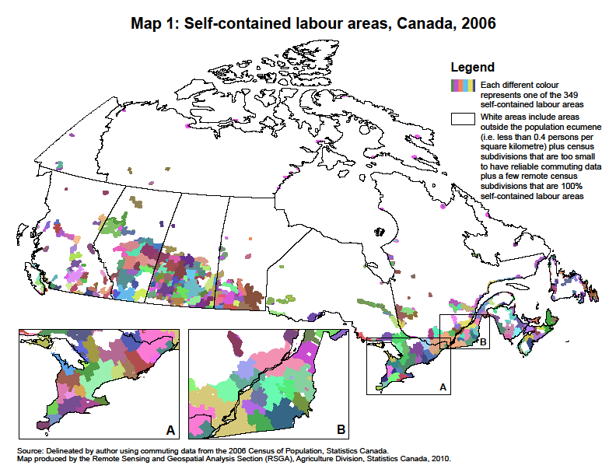
Understanding Rural Canada:
Implications for Rural Development Policy and Rural Planning Policy

Slide 24
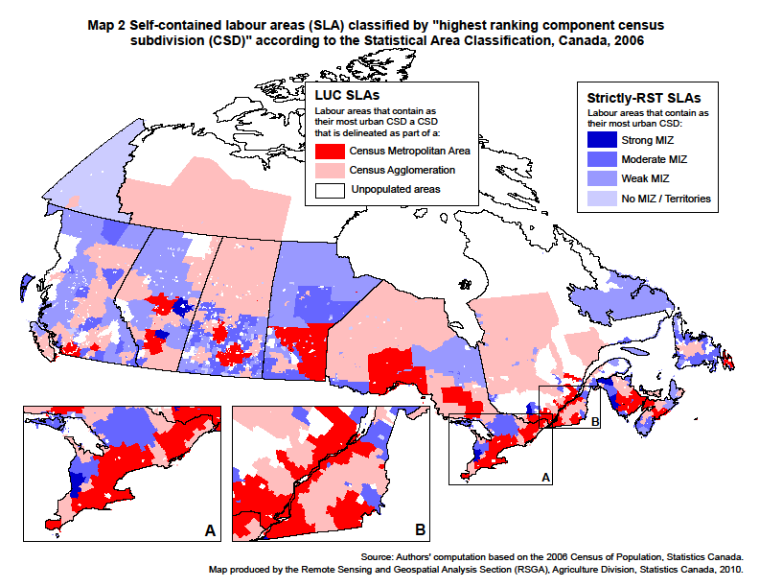
Understanding Rural Canada:
Implications for Rural Development Policy and Rural Planning Policy

Slide 25
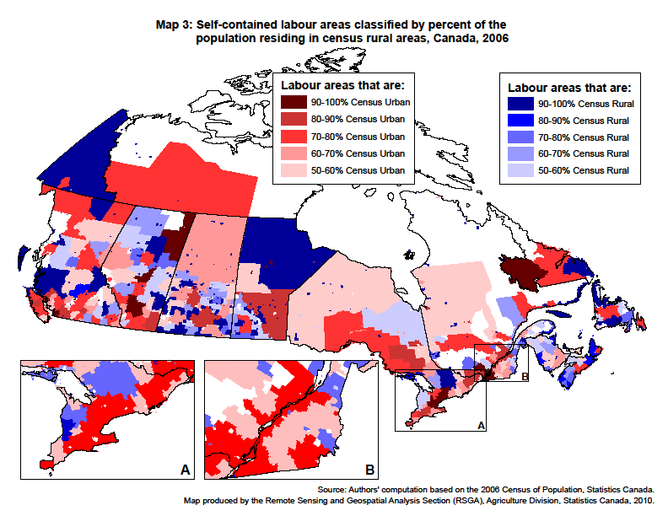
Understanding Rural Canada:
Implications for Rural Development Policy and Rural Planning Policy

Slide 26
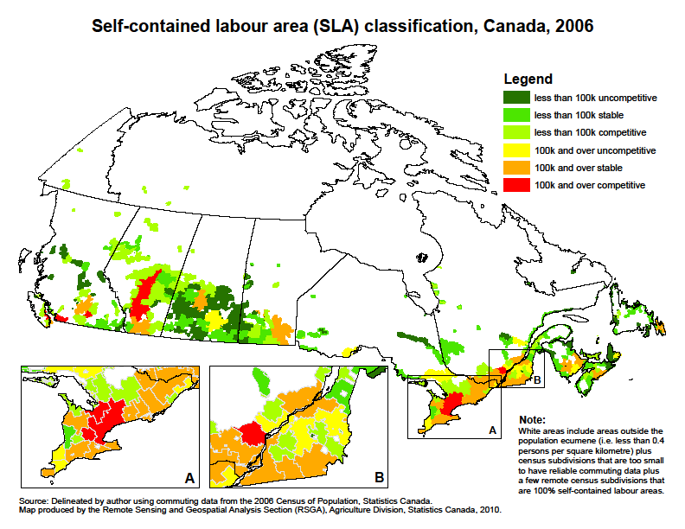
Understanding Rural Canada:
Implications for Rural Development Policy and Rural Planning Policy

Slide 27
Understanding Rural Canada:
Implications for Rural Development Policy and Rural Planning Policy

Slide 28
Understanding Rural Canada:
Implications for Rural Development Policy and Rural Planning Policy

Slide 29
Understanding Rural Canada:
Implications for Rural Development Policy and Rural Planning Policy

Slide 30
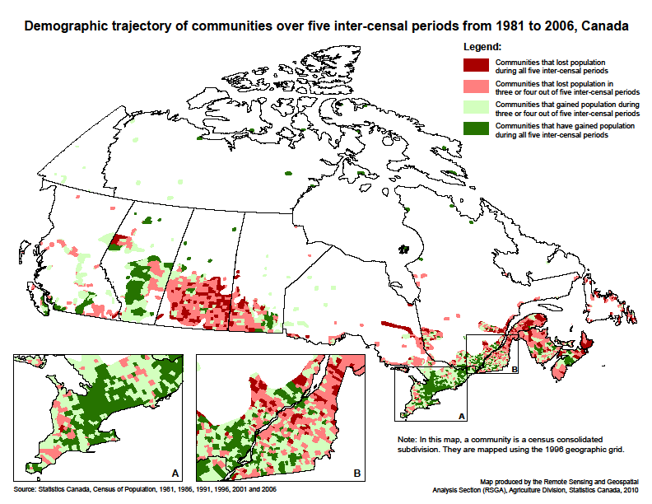
Understanding Rural Canada:
Implications for Rural Development Policy and Rural Planning Policy

Slide 31
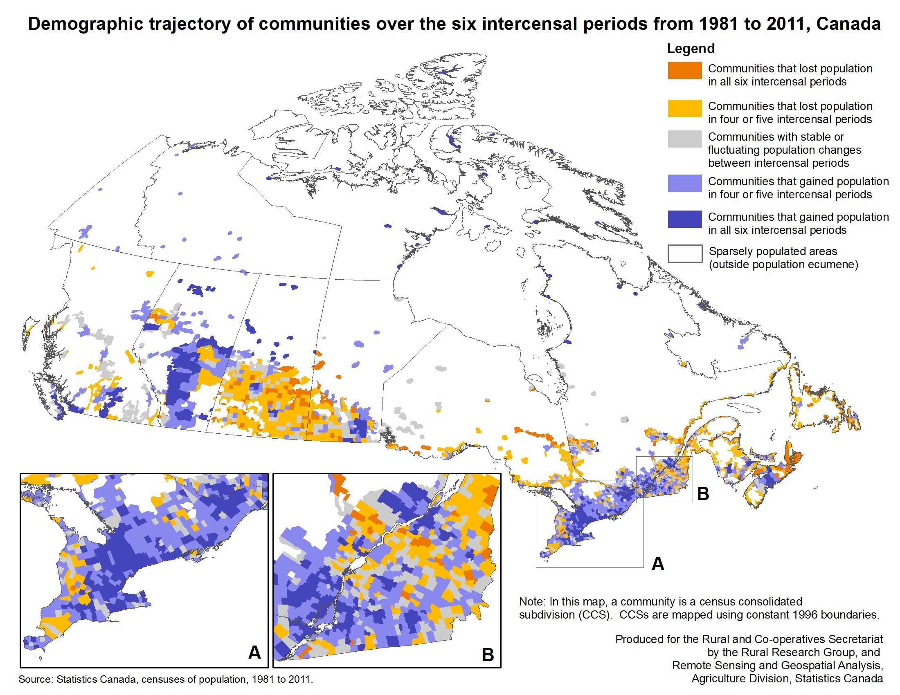
Understanding Rural Canada:
Implications for Rural Development Policy and Rural Planning Policy

Slide 32
Understanding Rural Canada:
Implications for Rural Development Policy and Rural Planning Policy

Slide 33
Understanding Rural Canada:
Implications for Rural Development Policy and Rural Planning Policy
Outline
Introduction
Context
What is policy?
What is rural?
What is rural policy?
Rural Manitoba
Summary

Slide 34
Understanding Rural Canada:
Implications for Rural Development Policy
and Rural Planning Policy
Presentation to the Rural+ Development + Planning Symposium
Brandon, February 22,2012
{This presentation is based on:
Reimer, Bill and Ray D. Bollman. (2010) “Understanding Rural Canada: Implications for Rural Development Policy and Rural Planning Policy.” Chapter 1 in David J.A. Douglas (ed.) Rural Planning and Development in Canada. (Toronto: Nelson Education Ltd.)
Ray D. Bollman
RayD.Bollman@sasktel.net
613-297-5826
Questions / Discussion

Slide 35
Understanding Rural Canada:
Implications for Rural Development Policy
and Rural Planning Policy
Presentation to the Rural+ Development + Planning Symposium
Brandon, February 22,2012
{This presentation is based on:
Reimer, Bill and Ray D. Bollman. (2010) “Understanding Rural Canada: Implications for Rural Development Policy and Rural Planning Policy.” Chapter 1 in David J.A. Douglas (ed.) Rural Planning and Development in Canada. (Toronto: Nelson Education Ltd.)
Update of Manitoba’s rural demography to 2011
Ray D. Bollman
RayD.Bollman@sasktel.net
613-297-5826

Slide 36
Take home messages:
Rural Manitoba is growing
  not everywhere, but Rural Manitoba is growing
  The rural share of total population is declining because
    Urban is growing faster;
    and due to
    Successful rural development
      At each census, some rural areas have grown and are re-classified as urban.
      Sometimes the re-classification is greater than the growth and thus we sometimes see fewer rural people at the end of the period, compared to the number at the beginning of the period.
Rural Manitoba is:
growing near Winnipeg
growing less or declining away from Winnipeg
some remote areas are growing due to higher Aboriginal birth rates and / or resource development.

Slide 37
Three ways of following rural demography
Nature of community / neighbourhood (census rural areas)
Type of labour market
  (rural and small town (non-CMA/CA) areas)
Type of region
  (predominantly rural regions, OECD regional typology)

Slide 38
Three ways of following rural demography
Nature of community / neighbourhood (census rural areas)
Type of labour market
  (rural and small town (non-CMA/CA) areas)
Type of region
  (predominantly rural regions, OECD regional typology)

Slide 39
Census rural areas and population centres
Census rural areas have with fewer than 1,000 inhabitants and a population density below 400 people per square kilometre. The terminology for all other areas has changed starting with the 2011 census.
Statistics Canada has defined census urban areas using the same methodology based on population size and density since the 1971 Census. An census urban area was defined as having a population of at least 1,000 and a density of 400 or more people per square kilometre.
Starting with the 2011 Census, the term 'population centre' replaces the term ‘census urban area.' Population centres are classified into one of three population size groups:
• small population centres, with a population of between 1,000 and 29,999
• medium population centres, with a population of between 30,000 and 99,999
• large urban population centres, consisting of a population of 100,000 and over.
A population centre is defined as an area with a population of at least 1,000 and a density of 400 or more people per square kilometre. All areas outside population centres continue to be defined as census rural areas. Taken together, population centres and census rural areas cover all of Canada.
Users of the former census urban area concept will be able to continue with their longitudinal analysis using population centres.
For more information, please see the note titled From urban areas to population centres, available on the Statistics Canada website, which explains the new terminology and classification of population centres.

Slide 40
Within census rural areas, population densities and living conditions can vary greatly. Included in census rural areas are:
. . . small towns, villages and other populated places with less than 1,000 population according to the current census;
. . . rural fringes of census metropolitan areas and census agglomerations that may contain estate lots, as well as agricultural, undeveloped and non-developable lands ;
. . . agricultural lands;
. . . remote and wilderness areas.
Note that both population centres and census rural areas may exist within each of the “higher” geographical groups. Thus, population centres and census rural areas may be used as variables to cross-classify census data within any standard geographic areas such as census subdivisions, census divisions, census metropolitan areas, census agglomerations or census Metropolitan area and census agglomeration Influenced Zones (MIZ).
40
Notes:
40

Slide 41
Understanding Rural Canada:
Implications for Rural Development Policy and Rural Planning Policy

Slide 42
Understanding Rural Canada:
Implications for Rural Development Policy and Rural Planning Policy

Slide 43
Understanding Rural Canada:
Implications for Rural Development Policy and Rural Planning Policy

Slide 44
Three ways of following rural demography
Nature of community / neighbourhood (census rural areas)
Type of labour market
  (rural and small town (non-CMA/CA) areas)
Type of region
  (predominantly rural regions, OECD regional typology)

Slide 45
Larger urban centres (LUCs) are Census Metropolitan Areas (CMAs) and Census Agglomerations (CAs):
  Census Metropolitan Areas (CMAs) have a built-up core population of 50,000 or more with a total population of 100,000 or more (prior to 2006, the built-up core threshold was 100,000).
  Census Agglomerations (CAs) have a built-up core population of 10,000 or more with a total population of less than 100,000 (prior to 2006, a few CAs had a total population over 100,000 if they had less than 100,000 in the built-up core – due to the different definition of a CMA prior to 2006).
Both CMAs and CAs include the total population of neighbouring census subdivisions (CSDs) (i.e., incorporated towns and municipalities) where more than 50% of the employed residents commute (i.e. a measure of social-economic integration) to the built-up core of a specific CMA or CA. More details of the delineation are available from Statistics Canada (2007). {Statistics Canada. (2007) 2006 Census Dictionary (Ottawa: Statistics Canada, Catalogue no. 92-566)} (http://www12.statcan.gc.ca/english/census06/reference/dictionary/index.cfm)}
Rural and small town (RST) areas refer to non-CMA/CA areas. RST areas are divided into five types of zones based on the degree of influence (i.e., commuting) to any LUC. These zones are Census Metropolitan and Census Agglomerated Influenced Zones (MIZs) (Statistics Canada, 2007). They are defined as follows:
… Strong MIZ includes CSDs where at least 30% of the employed residents commute to any CMA or CA;
... Moderate MIZ includes CSDs where 5% to less than 30% of the employed residents commute to any CMA or CA;
… Weak MIZ includes CSDs where more than zero but less than 5% of the employed residents commute to any CMA or CA;
… No MIZ includes CSDs where none of the employed residents commute to any CMA or CA (or the number of employed residents is less than 40); and
… RST Territories refers to the non-CMA/CA parts of the Yukon, the Northwest Territories and Nunavut (i.e. the areas outside the CAs of Whitehorse and Yellowknife).
{See du Plessis, Valerie, Roland Beshiri, Ray D. Bollman and Heather Clemenson. (2001) “Definitions of Rural.” Rural and Small Town Canada Analysis Bulletin Vol. 3, No. 3 (Ottawa: Statistics Canada, Catalogue. no. 21-006-XIE). (http://www.statcan.gc.ca/bsolc/olc-cel/olc-cel?catno=21-006-X&CHROPG=1&lang=eng)}
45
Notes:
45

Slide 46
Understanding Rural Canada:
Implications for Rural Development Policy and Rural Planning Policy

Slide 47
Understanding Rural Canada:
Implications for Rural Development Policy and Rural Planning Policy

Slide 48
Understanding Rural Canada:
Implications for Rural Development Policy and Rural Planning Policy

Slide 49
Understanding Rural Canada:
Implications for Rural Development Policy and Rural Planning Policy

Slide 50
Understanding Rural Canada:
Implications for Rural Development Policy and Rural Planning Policy

Slide 51
Understanding Rural Canada:
Implications for Rural Development Policy and Rural Planning Policy

Slide 52
Understanding Rural Canada:
Implications for Rural Development Policy and Rural Planning Policy

Slide 53
Understanding Rural Canada:
Implications for Rural Development Policy and Rural Planning Policy

Slide 54
Understanding Rural Canada:
Implications for Rural Development Policy and Rural Planning Policy

Slide 55
Understanding Rural Canada:
Implications for Rural Development Policy and Rural Planning Policy

Slide 56
Three ways of following rural demography
Nature of community / neighbourhood (census rural areas)
Type of labour market
  (rural and small town (non-CMA/CA) areas)
Type of region
  (predominantly rural regions, OECD regional typology)

Slide 57
OECD Regional Typology is designed to classify Territorial Level 3 (TL3) geographic units according their degree of rurality. In each country, TL1 refers to the national level, TL2 refers to the province level (in Canada or, for example, the state level in Australia or the United States) and TL3 refers to a subprovincial geographic grid. In Canada, TL3 units are census divisions.
Predominantly urban regions are census divisions where less than 15% of the population lives in an OECD rural community.
Intermediate regions are census divisions where between 15% and 50% of the population lives in an OECD rural community.
Predominantly rural regions are census divisions where more than 50% of the population lives in an OECD rural community. Predominantly rural regions are further classified to recognize diversity among the rural regions.
  Rural metro-adjacent regions: predominantly rural census divisions which are adjacent to metropolitan centres.
  Rural non-metro-adjacent regions: predominantly rural census divisions which are not adjacent to metropolitan centres.
  Rural northern regions: predominantly rural census divisions which are classified as “northern” when Beale Codes were assigned to Canadian census divisions. For details, see du Plessis et al. (2001). The 10 Beale Codes were designed for use in the USA. However, they did not include anything like Canada’s north so an eleventh code was added. This extra code includes census divisions that are found entirely, or a majority, above the following lines of parallel in each province: Newfoundland, 50th; Quebec and Ontario, 49th; Manitoba, 53rd; and Saskatchewan, Alberta and British Columbia, 54th. As well, rural northern regions include all of the Yukon, Nunavut and Northwest Territories. A map is available as Map B3 in Appendix B of the working paper by du Plessis et al. (2001). http://www.statcan.gc.ca/pub/21-601-m/21-601-m2002061-eng.htm
OECD rural communities: are census consolidated subdivisions (CCSs) with a population density less than 150 persons per km².
{See du Plessis, Valerie, Roland Beshiri, Ray D. Bollman and Heather Clemenson. (2001) “Definitions of Rural.” Rural and Small Town Canada Analysis Bulletin Vol. 3, No. 3 (Ottawa: Statistics Canada, Catalogue. no. 21-006-XIE). (http://www.statcan.gc.ca/bsolc/olc-cel/olc-cel?catno=21-006-X&CHROPG=1&lang=eng)}
57
Notes:
57

Slide 58
Understanding Rural Canada:
Implications for Rural Development Policy and Rural Planning Policy

Slide 59
Understanding Rural Canada:
Implications for Rural Development Policy and Rural Planning Policy

Slide 60
Understanding Rural Canada:
Implications for Rural Development Policy and Rural Planning Policy

Slide 61
Understanding Rural Canada:
Implications for Rural Development Policy and Rural Planning Policy

Slide 62
Understanding Rural Canada:
Implications for Rural Development Policy and Rural Planning Policy

Slide 63
Understanding Rural Canada:
Implications for Rural Development Policy and Rural Planning Policy

Slide 64
Understanding Rural Canada:
Implications for Rural Development Policy and Rural Planning Policy

Slide 65
Understanding Rural Canada:
Implications for Rural Development Policy and Rural Planning Policy

Slide 66
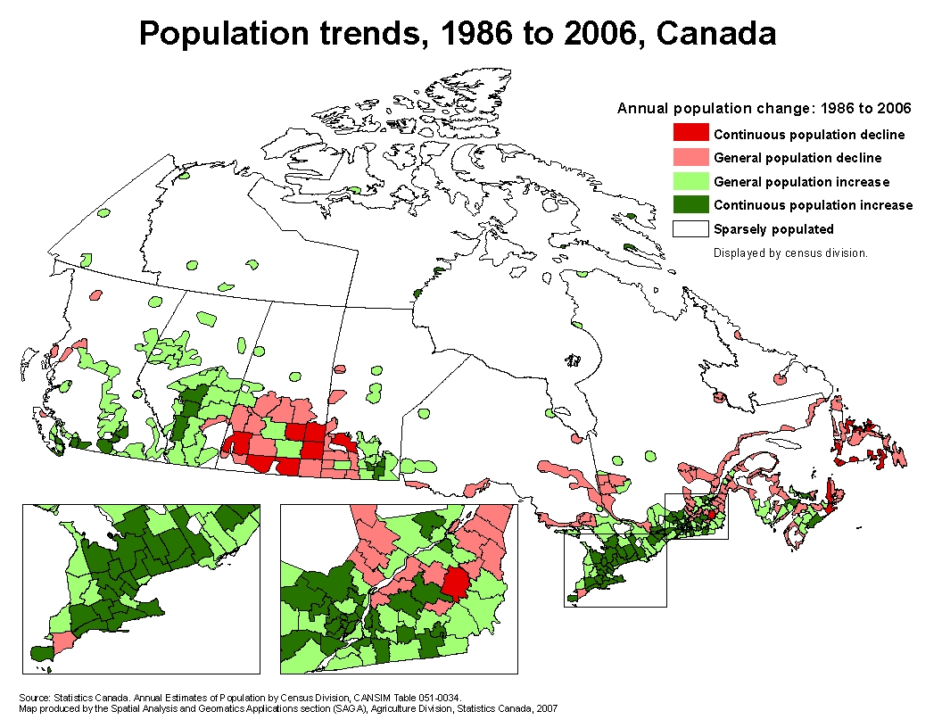

Slide 67
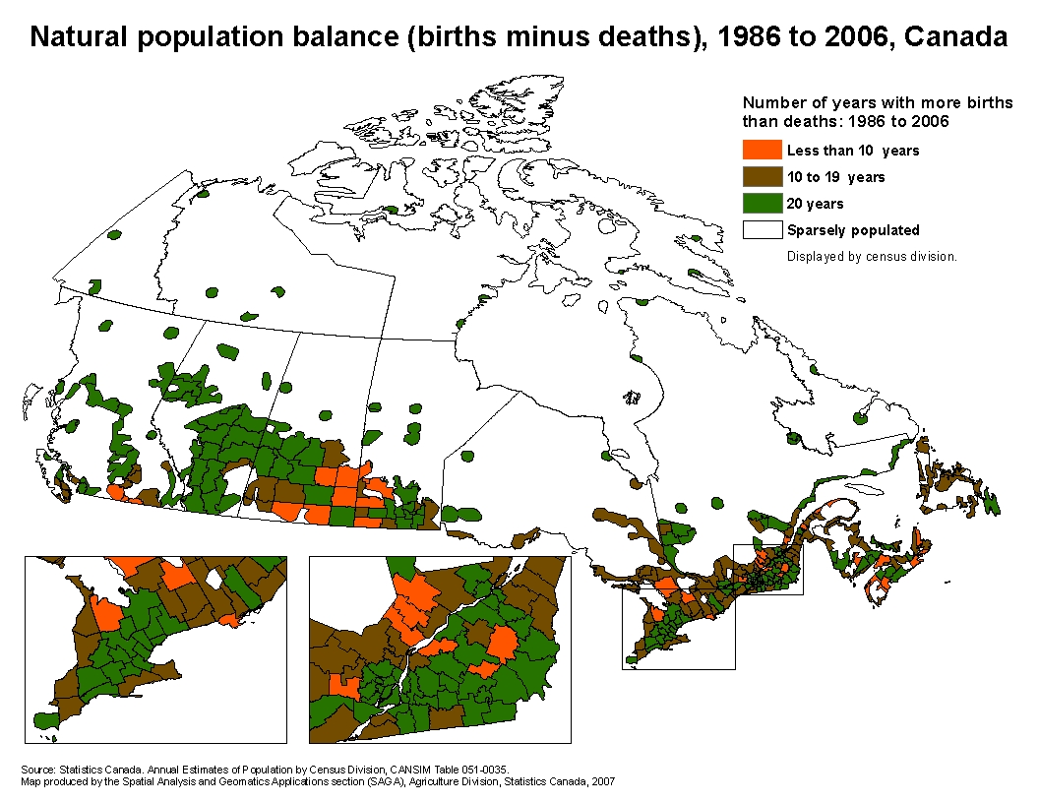

Slide 68
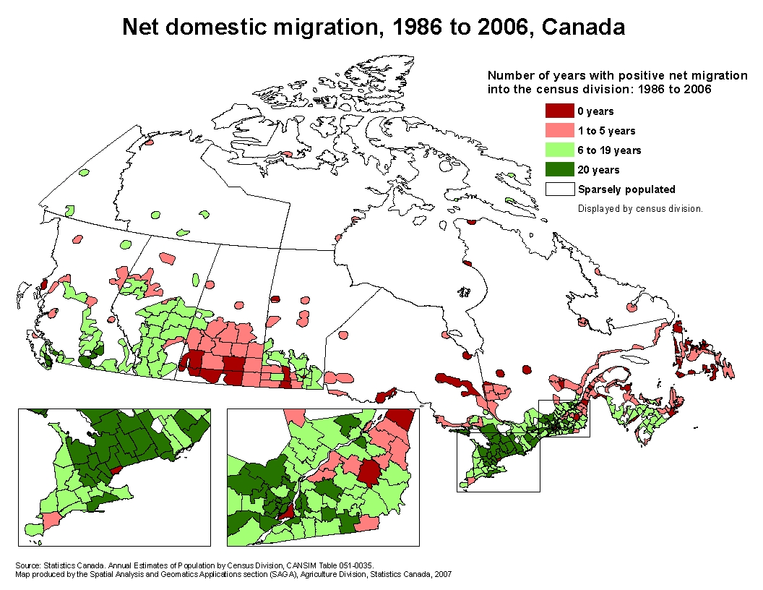

Slide 69
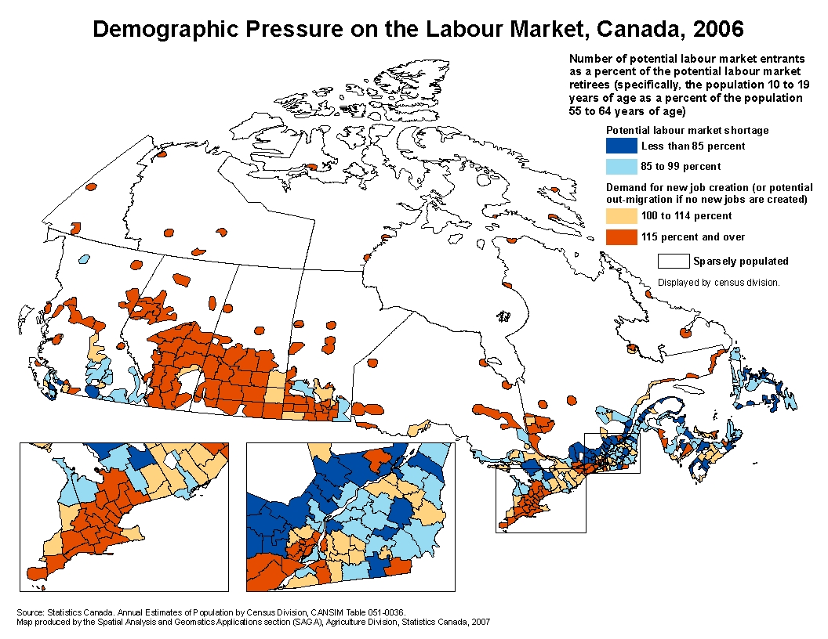

Slide 70
Demographic labour pressure index — ratio of
the persons (aged 10-19) who will enter the labour market
to the persons (aged 55-64) who will exit the labour market
during the next ten years because of ageing.
If the index is bigger than one,
the number of persons entering the labour market is larger
than the number of persons potentially leaving it because of ageing.
Source: Statistics Canada. Census of Population, 2006. Thanks to Chris Nichols, Rural Secretariat, for the chart.

Slide 71
Demographic labour pressure index — ratio of
the persons (aged 5-14) who will enter the labour market
to the persons (aged 55-64) who will exit the labour market
during the next ten years because of ageing.
If the index is bigger than one,
the number of persons entering the labour market is larger
than the number of persons potentially leaving it because of ageing.
Source: Statistics Canada. Census of Population, 2006. Thanks to Chris Nichols, Rural Secretariat, for the chart.

Slide 72
Understanding Rural Canada:
Implications for Rural Development Policy
and Rural Planning Policy
Presentation to the Rural+ Development + Planning Symposium
Brandon, February 22,2012
{This presentation is based on:
Reimer, Bill and Ray D. Bollman. (2010) “Understanding Rural Canada: Implications for Rural Development Policy and Rural Planning Policy.” Chapter 1 in David J.A. Douglas (ed.) Rural Planning and Development in Canada. (Toronto: Nelson Education Ltd.)
Miscellaneous
Ray D. Bollman
RayD.Bollman@sasktel.net
613-297-5826

Slide 73
What is driving rural?
Bollman, Ray D. (2007) Factors Driving Canada’s Rural Economy (Ottawa: Statistics Canada, Agriculture and Rural Working Paper No. 83, Cat. no. 21-601-MIE) (www.statcan.ca/cgi-bin/downpub/listpub.cgi?catno=21-601-MIE).
Schultz, T. W. (1972) “The Increasing Economic Value of Human Time.” American Journal of Agricultural Economics, Vol. 54, No. 5 (December), pp. 843 – 850.

Slide 75
The fact that the price of labour is increasing relative to the price of capital means that bigger machines will replace farmers, regardless of the trend in the price of commodities. Farms will get bigger and farming communities will have fewer farming families.

Slide 76
Agricultural output is up -- agricultural labour is down. Fewer people are required in agriculture. This trend is on-going – regardless of the price of farm outputs. Consequently, the challenge for rural communities is to find something new to export to maintain a population base.

Slide 77
What are the major sectors in rural?

Slide 80
What are the major sectors in rural?
➔ manufacturing
and
    ➔ rural and small town Canada is competitive in manufacturing

Slide 81
“The plural of ‘anecdote’ is not evidence”
Notes:
Territorial indicators address two sets of questions posed by national policy analysts:
One set of questions is – “Tell me about territorial-specific policies? What are the characteristics of the targeted units? Which territorial units ‘should’ be targeted?
Another set of questions is – “Tell me about now national (universally applicable across the country) policies impact different sub-national territorial units differently.”

Slide 82
“ . . . infrastructure (roads, airports, schools, Internet service, etc.) would not be viewed as a driver of rural development.
Infrastructure would be viewed as responding to development.
The words of Mrs. Skinner, during the protest of the closure of the town hospital, are key:
In time, we realized the truth – that we did in fact have a hand in making that decision. Fifty years of complacency had allowed our community to shrink in population, economic viability and regional importance.
(Quoted in Scholz (2002), p. 34)

